Slide 1
412 Week 3 Progress
by: Yousef Alkhelaifi, Calvin Xaybanha, Yikun Wang, Yudi Bao, Brandon Garcia

Slide 2
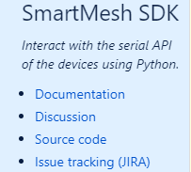
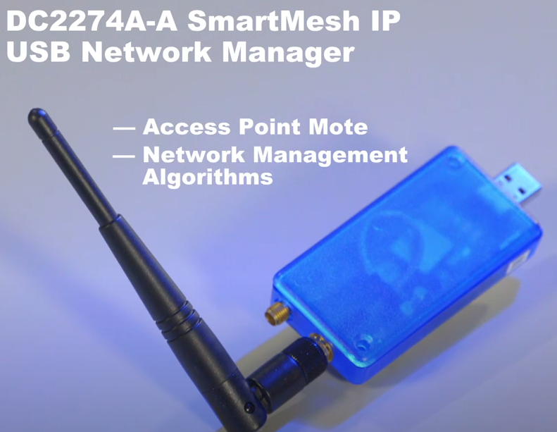
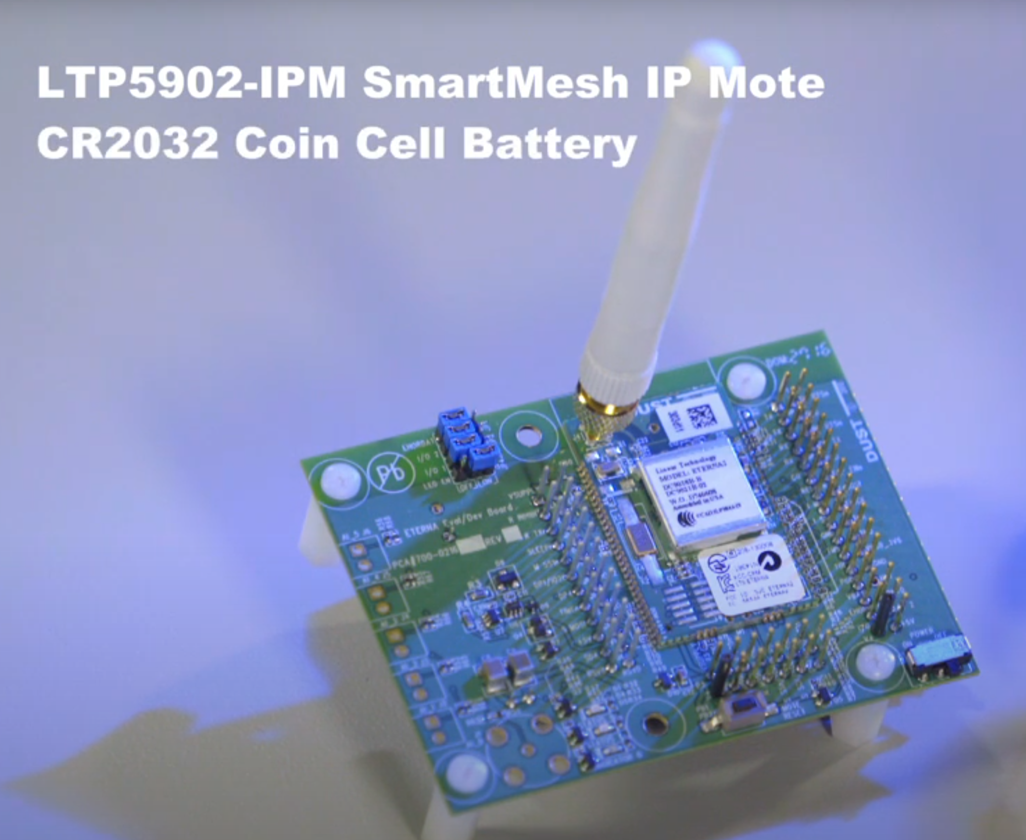
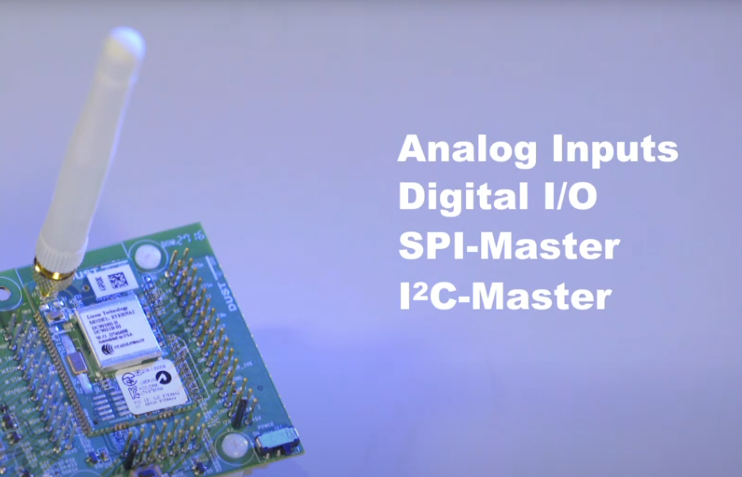
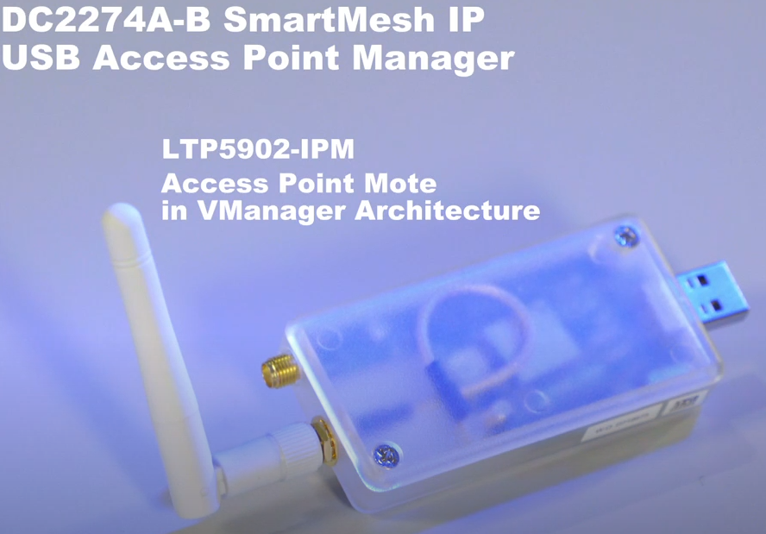
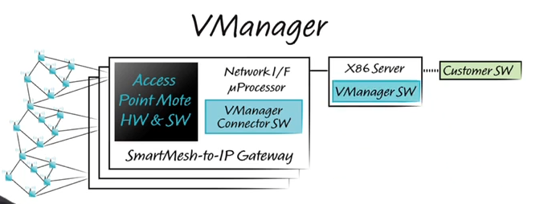
Yousef Al-Khelaifi
Completed:
Research Smart mesh amstermode and starter kit
Starter kits provides wireless modules pre-soldered onto evaluation boards to provide quick access to I/O via headers.
www.Dustcloud.org , provides source code and extensive documentation for each side of the SmartMesh IP system, most smart mesh source code is written in python, however there are C-libraries for running the wireless module in slave-mode.
Starter-kit comes with all evaluation hardware necessary to set up custom PCB-wireless module designs using serial interface boards.
100 mote system can be made with single access point mote(blue) USB Emanager, however 1000+ mote networks are made with multiple access point mote(white) and combined in software using a virtual machine scheme called Vmanager
Added to more info to L1-diagram

Slide 3
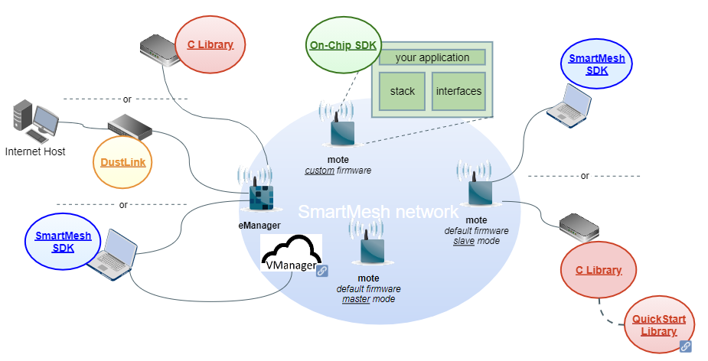
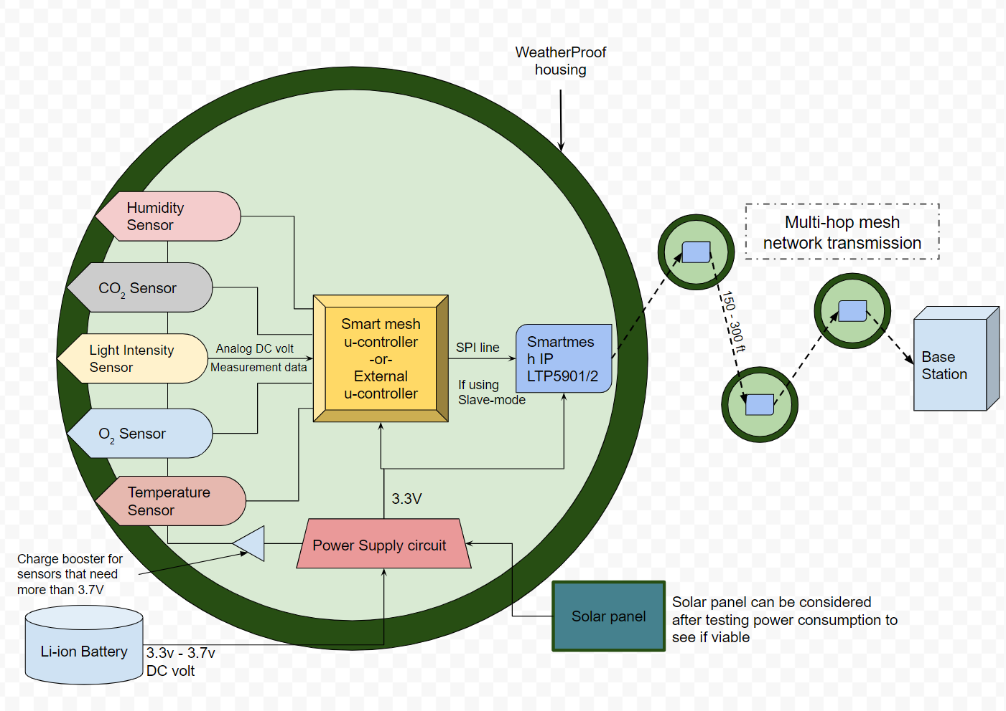
In-progress
Battery life estimation in mAh (continued from last week)
Dive deeper into dustcloud.org
Acquire starter kit and do some hands-on testing, first prototype can be completed by connecting configured sensors into analogue inputs using the dust more evaluation board headers

Slide 4
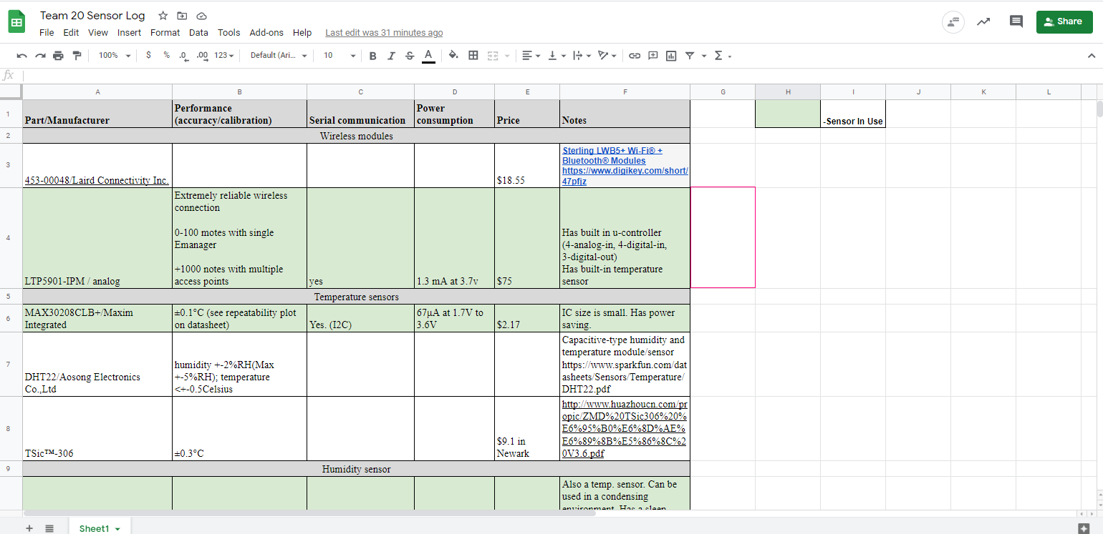
Brandon Garcia
Researched CO2, O2 from Sensirion and also the Wind Speed Sensor
Spreadsheet for Sensor Log
2nd Meeting Availability?

Slide 5
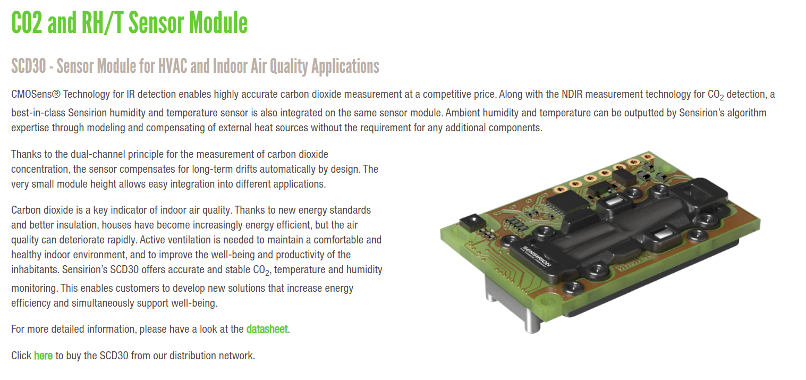
CO2 Sensor Info:
Sensirion SCD30 Sensor Specs:
Only indoor?
Small in size(35x23x7mm)
Low power
(19mA- 3.3-5.5V)
Range: 400 ppm-10k ppm
Accuracy: +- 30 ppm
High cost @ $51.31 via Mouser

Slide 6
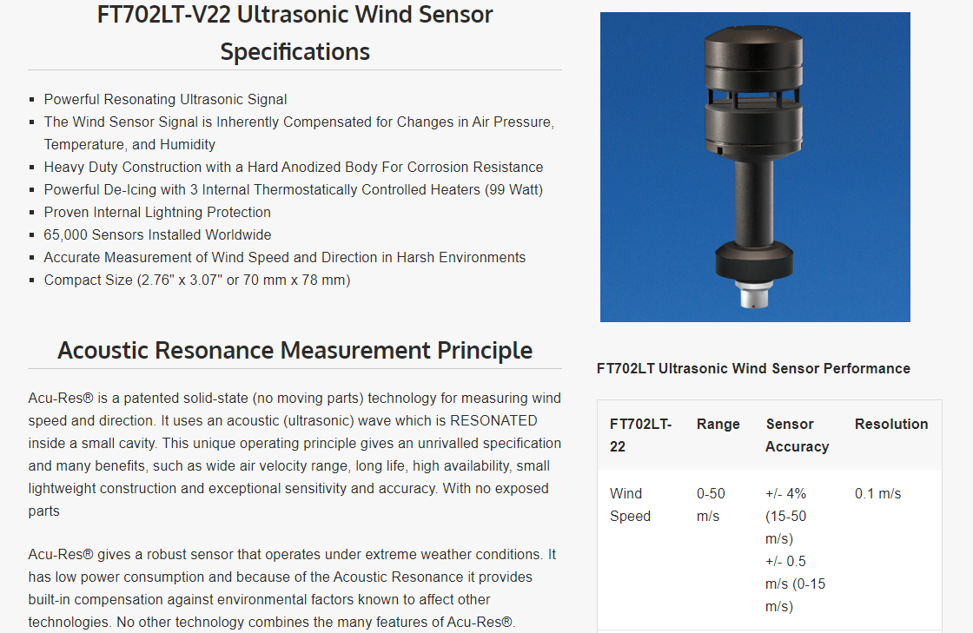
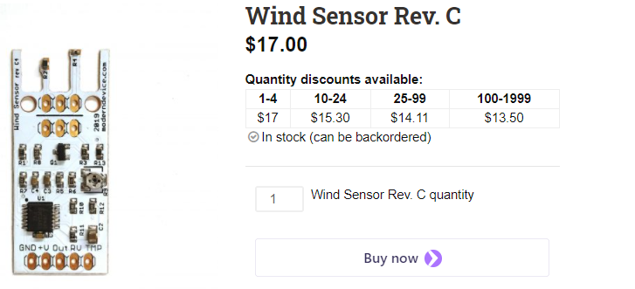
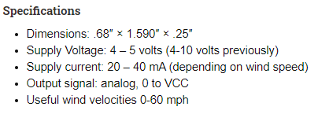
Wind Speed & Direction Sensor Info:
Types of Anemometers
Ultrasonic - Has no moving parts, sonic pulse disruption are measured for wind speed.
Laser Doppler - Uses the doppler effect to detect wind speed.
Hotwire - A hot wire or thermal flow measures wind speed/ pressure. A direct relationship exists between the rate at which the wind is flowing and how cool the wire becomes

Slide 7
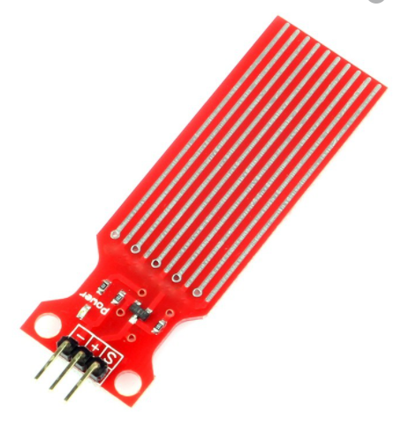
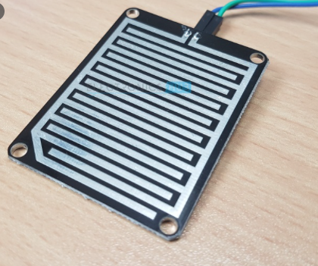
Water Contact Sensor
Water Level Strip:
Rain Detector:

Slide 8
Yikun Wang
Completed:
Research on more detail about light sensor and choose the suitable one.
Research on vibration sensor.
Research on water sensor.
In-progress:
Research on Wind speed and direction sensor

Slide 9
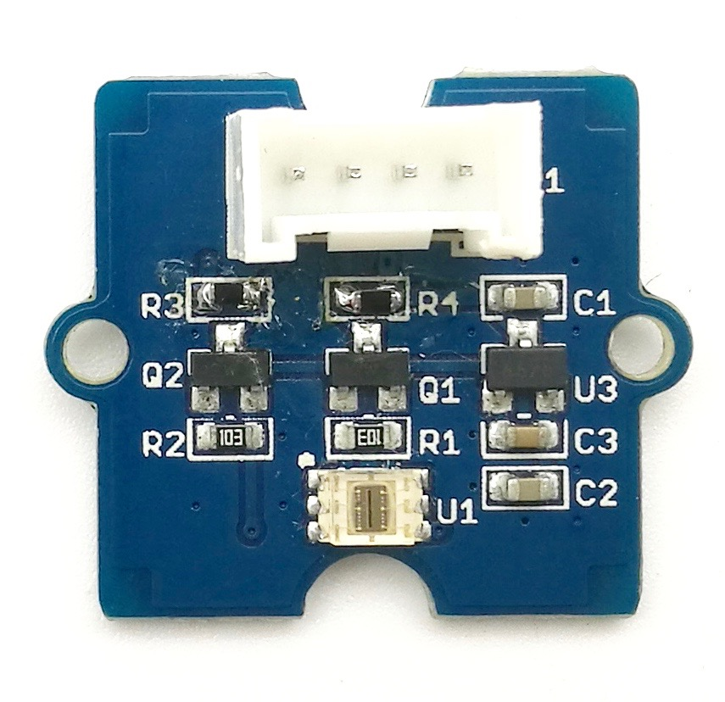
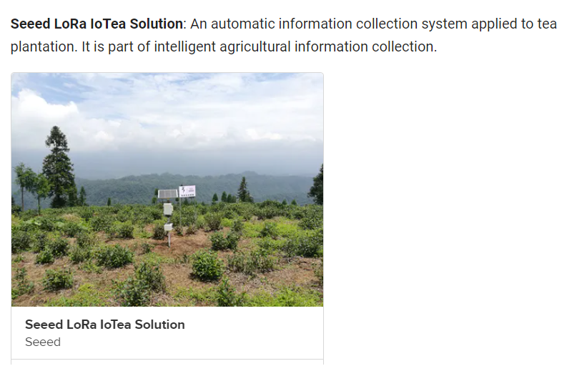
Digital Light Sensor(TSL2561)
Basing on the I2C light-to-digital converter TSL2561 to transform light intensity to a digital signal.
This digital module features a selectable light spectrum range. We can switch among three detection modes to take your readings. They are infrared mode, full spectrum and human visible mode.
Wide dynamic range: 0.1 - 40,000 LUX
Supply voltage: 3.3V-5.1V
Size: 24mm x20mm x9.8mm
Price: 9.9$
It could be programed in Arduino and Raspberry Pi

Slide 10
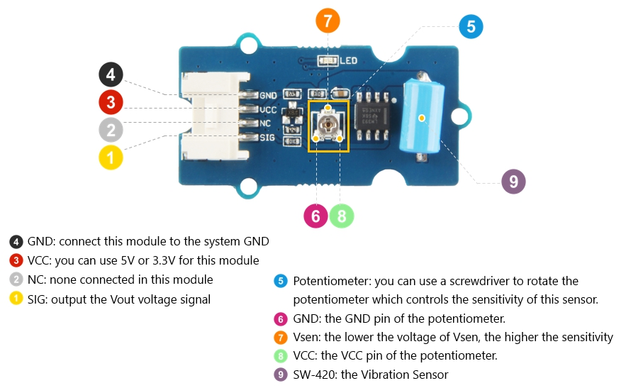
Vibration Sensor(SW-420)
High sensitivity, respond to vibration and tilt, also waterproof.
When it moves, shakes or tilts the Vibration Sensor, the buzzer will ring.
Supply voltage: 3.3V-5.0V
Size: 40mm x20mm x10mm
Price: 2.5$
It could be programed in Arduino.

Slide 11
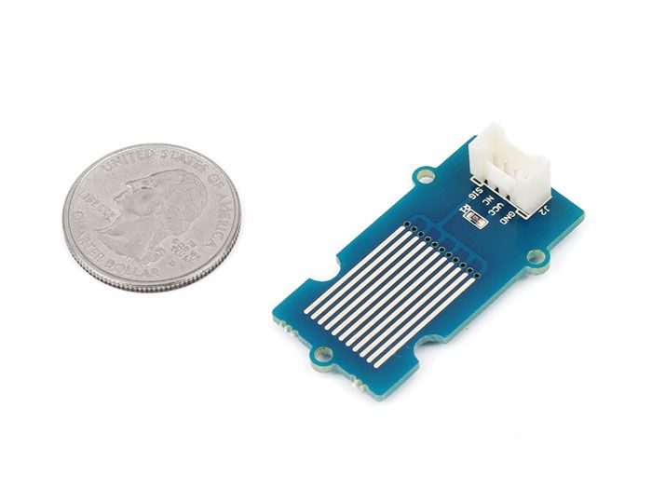
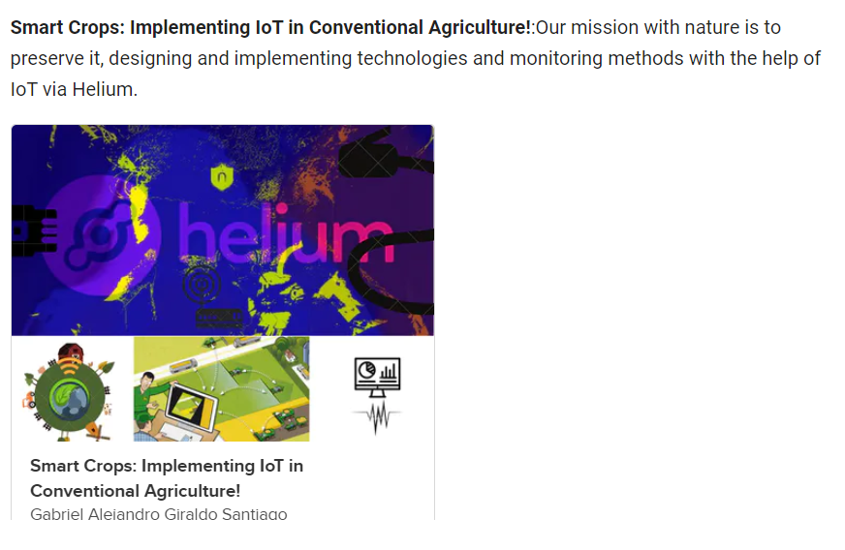
Water Sensor V1.1
It indicates whether the sensor is dry, damp or completely immersed in water by measuring conductivity.
Low power consumption and high sensitivity
Supply voltage: 4.75V-5.25V
Size: 40mm x20mm x12mm
Price: 2.9$
It could be programed in Arduino.

Slide 12
Yudi Bao
Completed:
Research for VMware
VMware is a x86 virtual machine software of windows. Because all dustcloud software must run on this environment.
Research for how to use Emanager
Original python code for Smartmesh SDK, stargazer which is network manager software…...
In progress：
Solve downloading problems and figure out some questions
Get parts to build systems in real environment

Slide 13
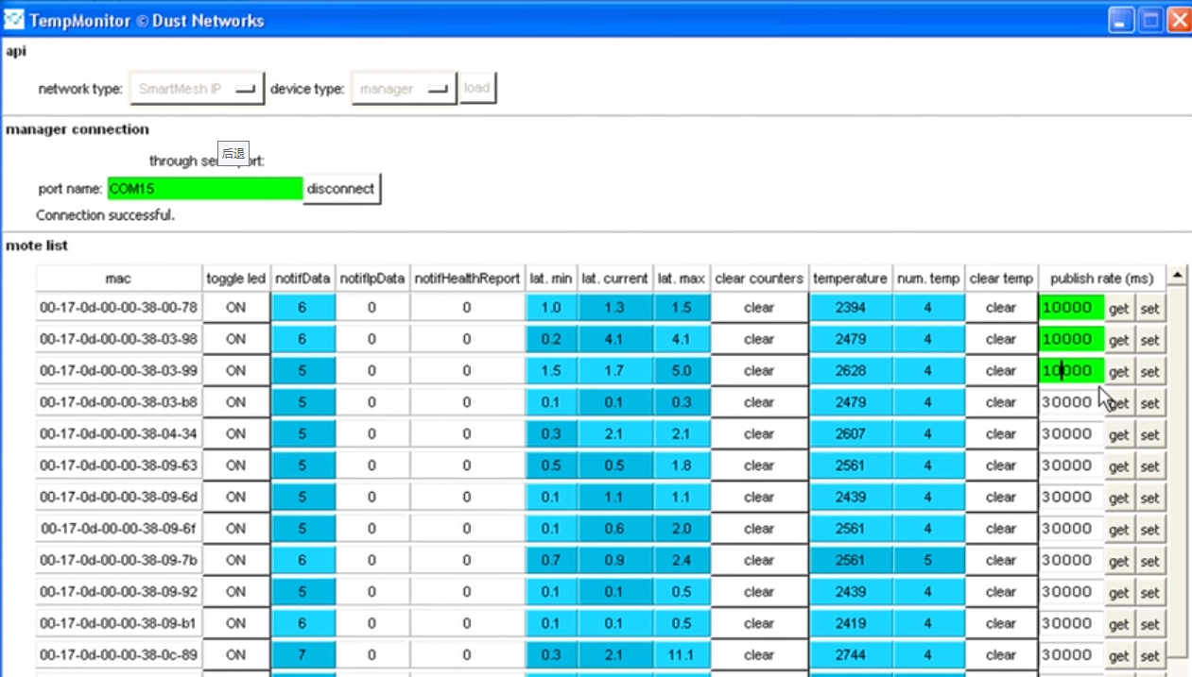
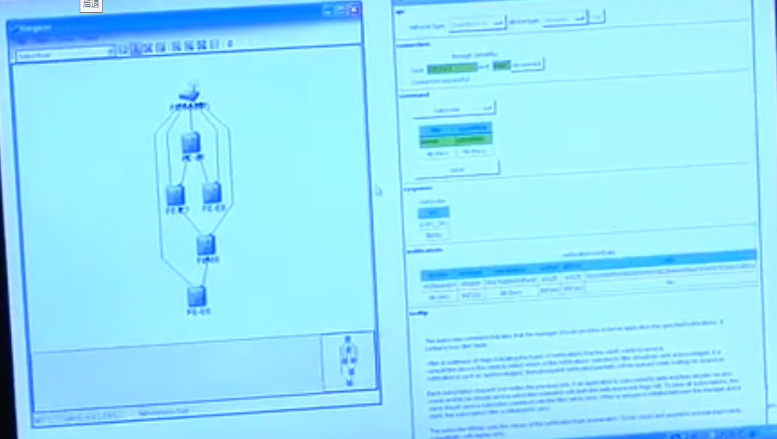
Emanager interface
And function
Smartmesh IP network
Multi-Hop,IPv6-Ready Redundant, Low power
Automatic join process
Built-In security
Smartmesh manager
Constantly Optimizes the Network
Reacts to changes in the Environment
Focus on your application

Slide 14
How Emanager can help us
Manager can help us manage different kind of data and combine them into one data processing center.
By using manager software
We can control the collection speed of the sensor or the switching situation, which is conducive to improving the accuracy and efficiency of the data.
We can reduce the energy consumption of the data center by adding intelligent sensing systems. The way to reduce the energy is to reduce downtime in the data center or control sensor operation to reduce power consumption…...
resource:https://www.youtube.com/watch?v=qKtZ6rY4H6U

Slide 15
Calvin Xaybanha
Completed:
Research usability of a GUI for an end-user
Stargazer GUI (Dust Networks)
Connects to SmartMesh network manager
Able to display network topology as an overlay to a mapview image
Able to display status of motes and paths, current data, and monitor network statistics
Motes must be in master mode to work
Research SmartMesh module integration with Network Manager
FTDI serial drivers for communication from computer to hardware (if not installed).
Serial API Multiplexer (Serial Mux) - Allows multiple processes to communicate with the manager’s serial API.
TCP connection
Stargazer
SmartMesh SDK (SMSDK) - Python-based set of tools to demo aspects of motes and manager API. (Along with Python)

Slide 16
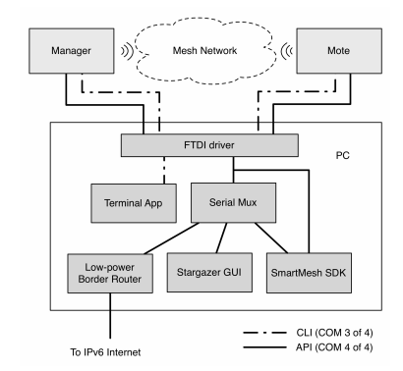
Software tools for SmartMesh IP Network Interaction
Image provided by Linear Technology and Dust Networks.

Slide 17
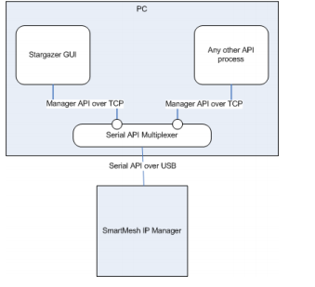
Serial Mux
Image provided by Linear Technology and Dust Networks.

